Slide 1
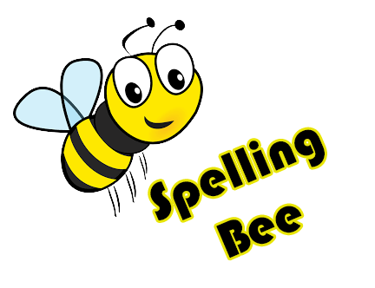
Spelling Bee, The Competition

Slide 2

Story Premise
You’re an aspiring teen who’s stepping into the competitive Spelling Bee for the first time
With your amazing amount of dedication for a teen with high expectations, you WILL reach the top of the Global Spelling Bee Ranking!

Slide 3



Genre and Platforms
Management
Typing
Learning

Slide 4
Concept
You are a new spelling bee competitor looking to reach to top ranks
Each day you can choose from a selection of different actions that can be performed
These actions can help train your character for the impending competition that follows every set amount of days
As you place higher in competitions, your placement on the Global Spelling Bee Ranking will increase

Slide 5

Gameplay Loop
Gameplay loop revolves around a system that uses days
All tournaments are scheduled on certain days
You’ll need to have enough time to participate as well as come prepared
Each day you are given a set of actions that you can perform
These take up a certain amount of time in a day

Slide 6
Available Actions
Sleeping:
Consumes rest of the day
Gain energy based on how much time is left
Energy is a very important resource for studying!

Slide 7
Available Actions cont.
Studying:
Time-based event based on how much “ENERGY” you have
Maximum time is THREE MINUTES
Consumes 1/4 of a day
You are given a Spelling Bee “Bible” and a set amount of time in order to cram
Time isn’t luxurious so take in as much information as possible!

Slide 8
Available Actions cont.
Training:
“Practice” competition
No penalties, no prizes, no rank changes
Consumes 1/4 a day

Slide 9
Available Actions cont.
Competition:
Every three days!
There are low-tier tourneys at the beginning of the game to start out
You’re given a word and will have to type it out in a limited amount of time
Can ask for a definition or a sentence that uses the word
Participants who answer correctly move to the next round

Slide 10
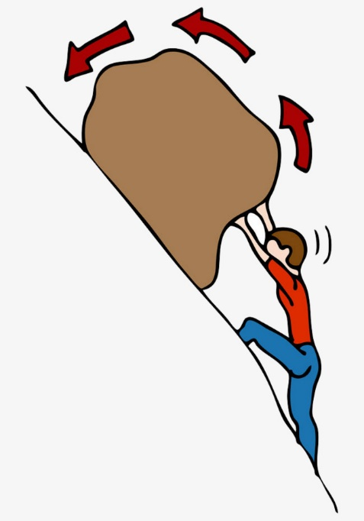
Difficulty
This game does have a time-limit on NORMAL Mode
Higher-tier tournaments unlock as you place higher!
More words unlock in your “Bible” that you’ll have to study
Words given in the higher-tier tournaments have more characters in them
Less time to study earlier on

Slide 11
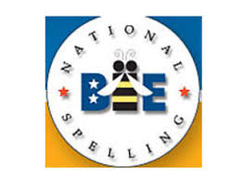
Licensing!

Slide 12
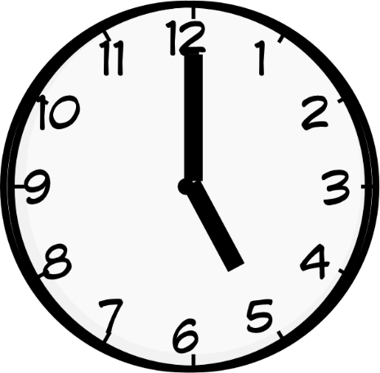
Development Time & Milestones
Complete Concept – 2 Months
Planning Phase – 3 Weeks
Art Concepts – 2 Weeks
First Prototype – 3 Months
Pitch
Licensing IP’s for National Competitions
Programming the mechanics – 3 Months
Overall Level and Game Design – 3 Months
Testing and Bug Fixing – 2 Months

Slide 13
Summary
You play as a new Spelling Bee competitor
A time limit is set for you to reach the top ranks
Balance sleeping, studying and practice in order to perform well
Adapt and overcome difficulty changes!

